Slide 1
The crime statistics of United States
Zhenyuan Gu
zhg42@pitt.edu
INFORMATION VISUALIZATION

Slide 2
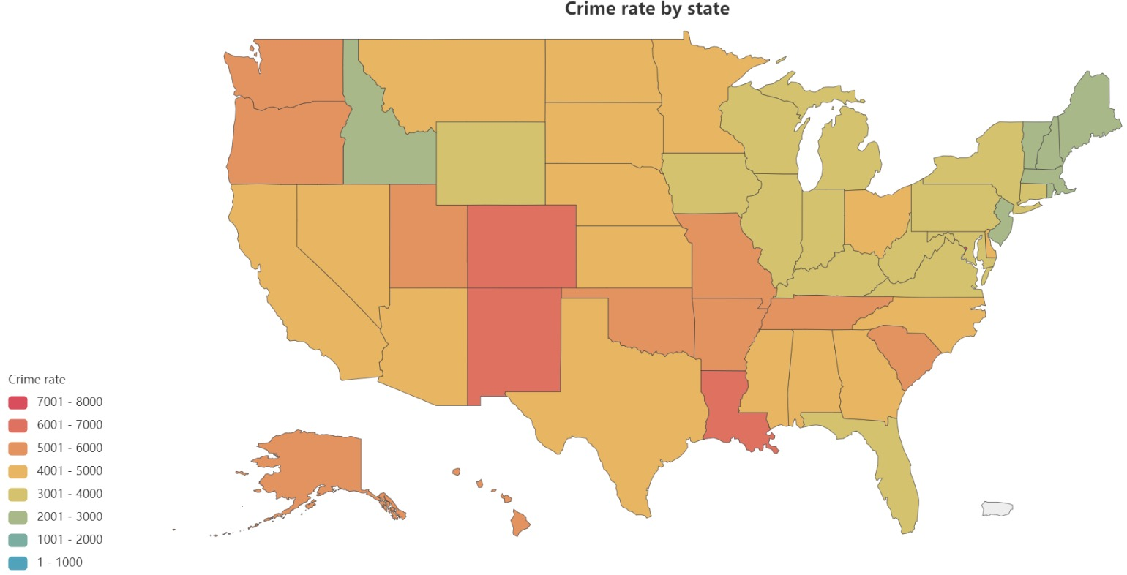
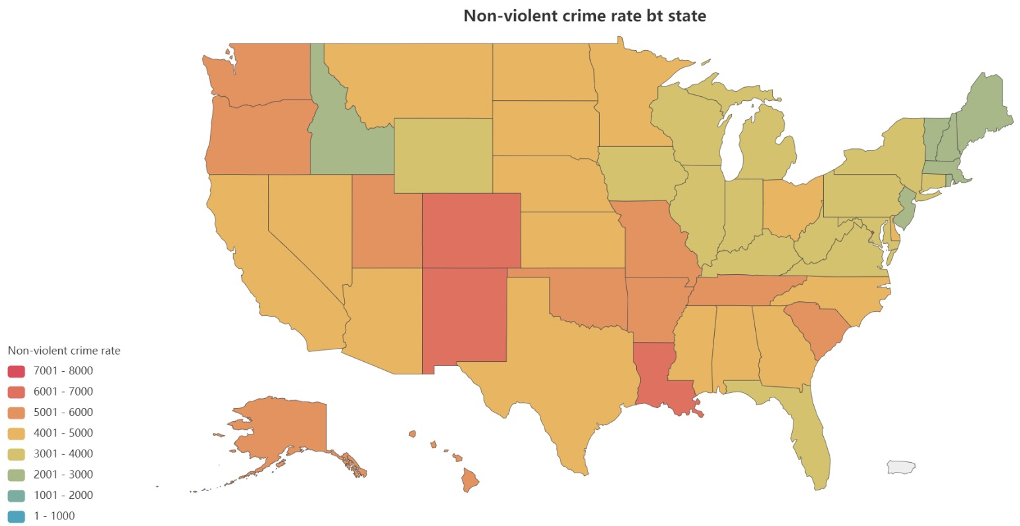
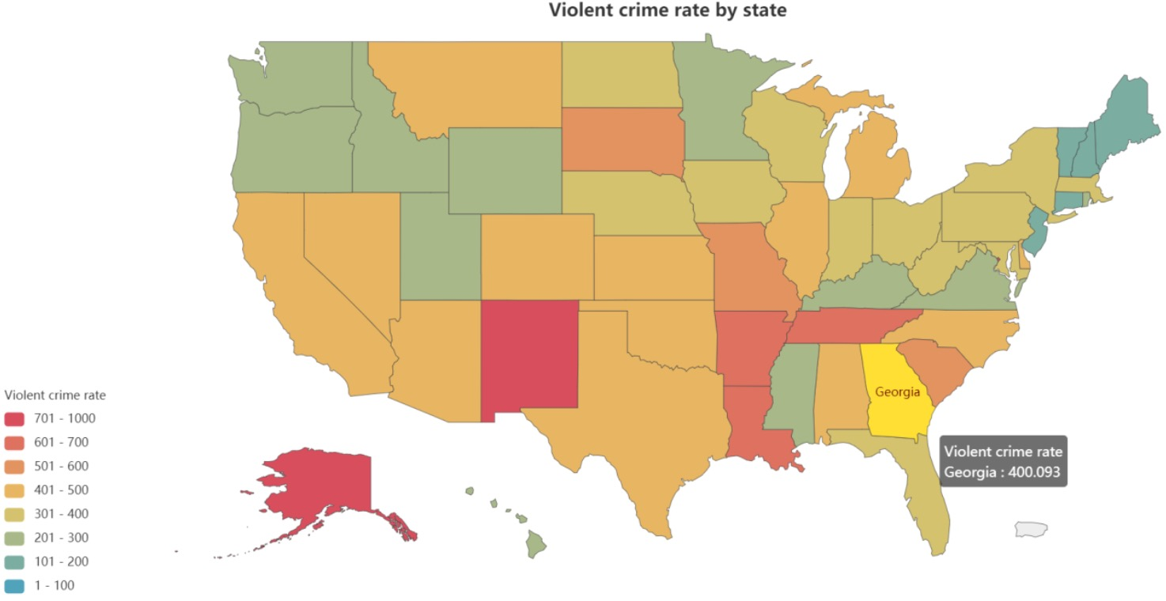
Overview of Crime Rates and Types in the United States
Violent vs. Property Crimes Percentage
Property crimes constitute the majority of crimes nationwide.
Maine: Lowest Crime Rate
Notes:
Our focus is on the crime rates across the United States, as illustrated in this map. Each state's crime rate is represented by a color gradient, providing an immediate visual understanding of the geographical spread of crime. Interestingly, our detailed analysis reveals that property crimes significantly outnumber violent crimes. This insight challenges common perceptions and underscores the need for targeted crime prevention strategies. The map offers a comprehensive picture of the national crime landscape.
Now, let's turn our attention to Maine, a state distinguished by its exceptionally low crime rate. Key to this is Maine's sparse population and the large area of uninhabited land. These factors drastically reduce opportunities for crime, setting Maine apart from more densely populated states.

Slide 3
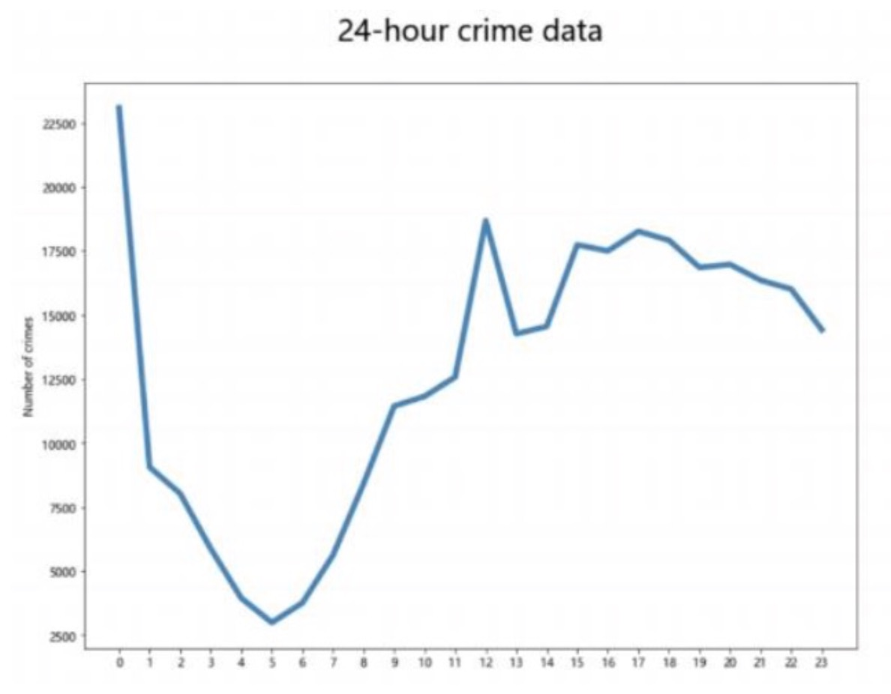
Case Study - Maine's Crime Rate and Daily Crime Analysis
Sparse population, Large uninhabited areas
Peak at Midnight, Lowest at 5 AM
Notes:
Furthermore, our 24-hour crime rate analysis uncovers a distinct pattern: the highest incidence of crime occurs around midnight, a time of lower public vigilance, while the lowest is at 5 AM. This temporal pattern is crucial for law enforcement, offering insights into when resources need to be most effectively deployed. Understanding these trends is vital for developing comprehensive public safety strategies.

